Slide 1

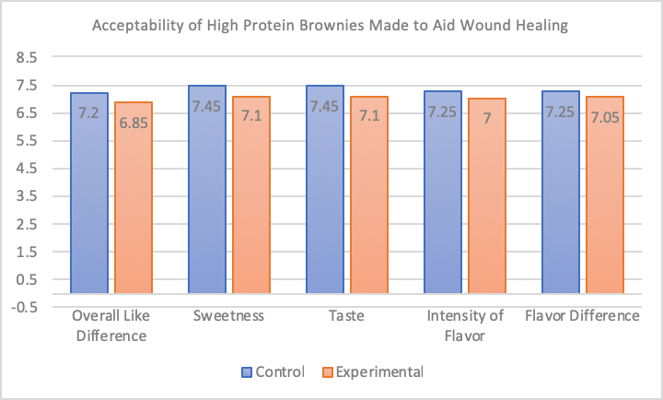
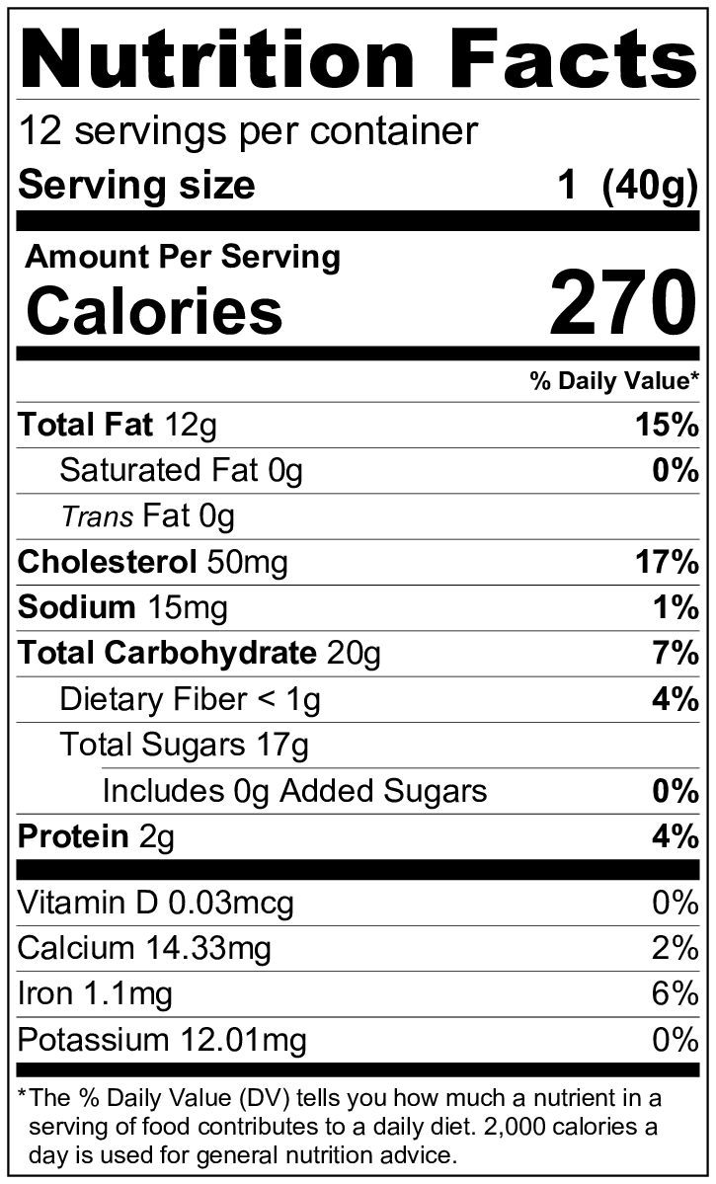
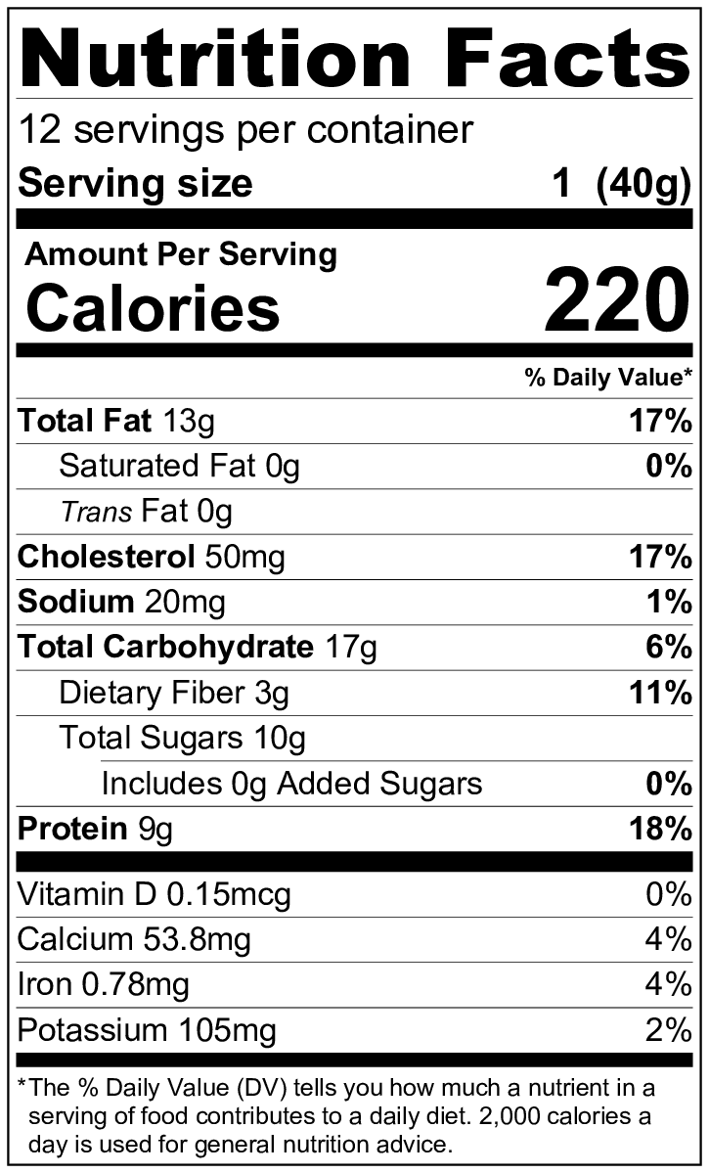
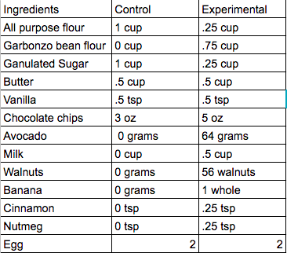
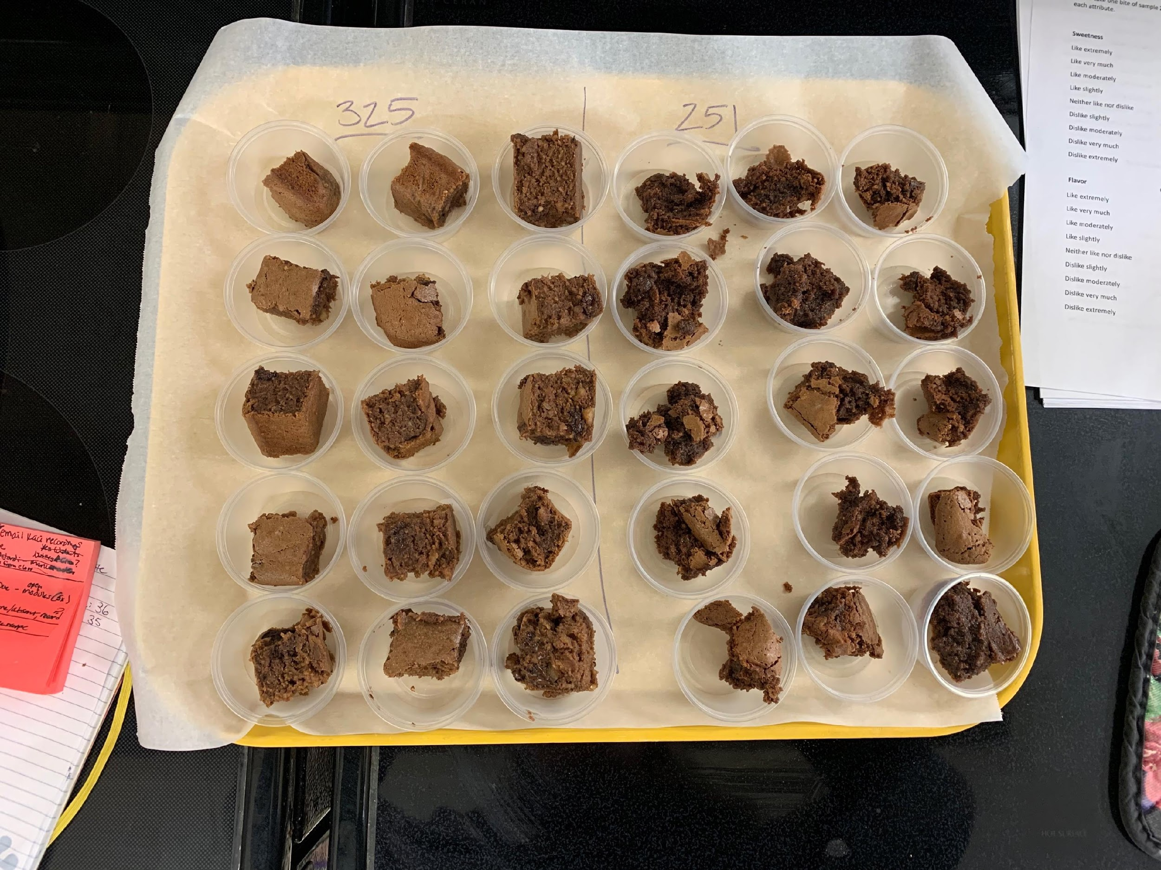
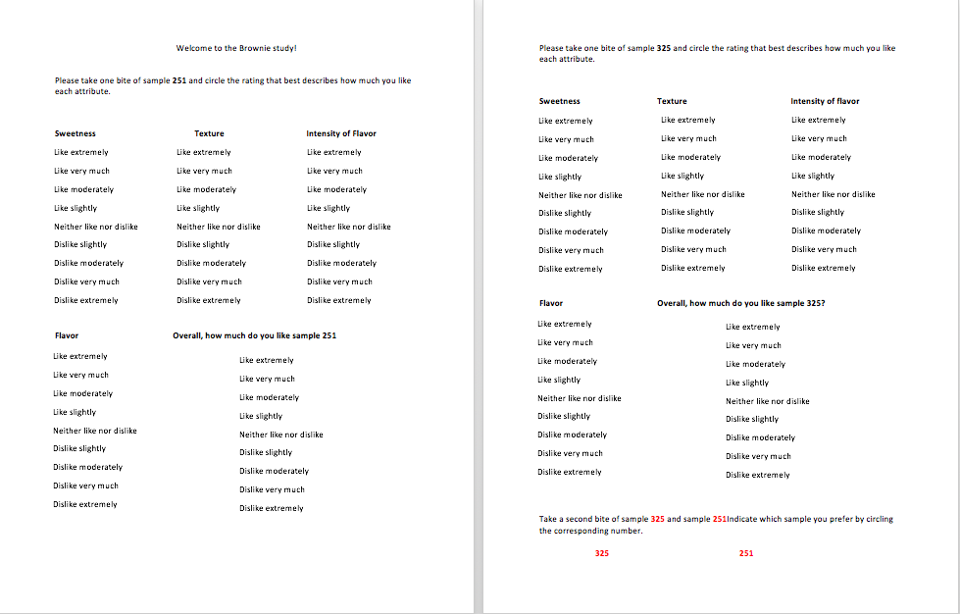
Acceptability of High Protein Brownies Made to Aid Wound Healing
TH. Carlson, KJ. Haney, JR. Orbeck
Introduction
Methods
Results
Previous research has shown that adequate protein intake during wound recovery guides the healing process at the desired rate; however more research is needed to determine the acceptability of foods with altered ingredients, specifically increased protein, in an attempt to increase consumption. The objective of this study was to examine the acceptability and sensory characteristics of high protein brownies.
Brownies were displayed side by side and labeled using an indicative number as not to give away their identity; Figure 1.
Figure 6 (right) illustrates mean differences in the sensory characteristics of the control and experimental brownies.
Nutrition Labels: Figure 3, on the right, is the control nutrition label. Figure 4 , on right, is the experimental nutrition label.
Methods
Conclusions
Twenty college students and faculty members were randomly selected to taste-test the brownies and rated their preference of texture, flavor, flavor intensity, sweetness, and overall preference on 9-point hedonic scales; as well as to indicate which brownie they preferred.
This outcome provides supporting evidence that high protein brownies are no less preferred than low protein, high sugar control brownies. The high protein brownies are an acceptable and more nutritious replacement for traditional brownies to be consumed by wound healing individuals. Further research should be conducted to test acceptance in a clinical setting. Further research is needed to assess the taste preferences and healing effects in a clinical setting.
Figure 5 (left) is a table of ingredients and ingredient amounts of both brownies side by side
Figure/Photo
Results
References
Analysis of the sensory characteristics concluded that none of the five attributes surveyed was statistically significant. Participants did report liking the flavor of the control sample no more than the flavor of the experimental sample [t(19)=1, p=.52); the experimental sample was not preferred (p= 0.82).
Demling R.H., DeSanti L. Increased protein intake during the recovery phase after
severe burns increases body weight gain and muscle function. J. Burn Care
Rehabil. 1998;19:161–168. doi: 10.1097/00004630-199803000-00015
Molnar JA, Underdown MJ, Clark WA. Nutrition and Chronic Wounds. Adv Wound
Care (New Rochelle). 2014;3(11):663-681.
Molnar J. A., Underdown M. J., Clark W. A. Nutrition and Chronic Wounds.
Advances in Wound Care. 2014;3(11):663–681. doi:
10.1089/wound.2014.0530.
Figure 1 shows samples displayed side by side, the control and experimental brownies each having a random number, for participants to evaluate.
Figure 2 displays the 9-point hedonic scale used by participants to rate preference

